Slide 1

IQ Innovation Contest Finalist
May 18, 2008
Ideaius
A web site where great ideas come to roost
Nathaniel Welch
nwelch@calpoly.edu
DevCloud Inc.
Faculty Sponsor/Advisor: Julie Workman
Innovation Quest – Learn by Doing…Give Back by Creating…

Slide 2
Product Description
Ideaius is a web application to revolutionize the innovation process through collaboration.
  Initial idea fits on the “back of a business card”
  Wiki / whiteboard for each new idea
  Extensive privacy options
  Folksonomy for categorizing users and their ideas
  Powerful user profile system

Slide 3
Product Application
To create an easy way for people to either submit their own ideas or collaborate and contribute to the development of others’ ideas in a free and open-source environment.
Ensure users can choose who can see their ideas and how the published information is copyrighted.
To help users go from an intangible idea to a solidified product.

Slide 4
Key Innovation
Products that could compete with us
  37 Signals' Basecamp
  Email
  Wikis
  Adobe Connect, Video Conferencing, AIM
  Bulbstorm
Brings multiple on-line tools together to create a single experience.
Group mentality to actualize ideas into reality.

Slide 5
Product Validation
We can validate very easily, the initial offering is free to try and the more people who use it consistently the more valuable it is.
Users gain input from the internet community. Nothing validates an idea like others telling you they would be interested in seeing it move further and provide ideas that are similar or expand on yours.

Slide 6
Project Logistics
Beta Release: December 17, 2008
Public Release: March 2009
Assume developers will clock 10hrs initially, increase hours
Initially two options
  Free
  $15
Summer '09 introduce another price level and more options
  Private company version
  Help getting in touch with investors, companies, etc.
The Internet. A Server. Developers.

Slide 7
Resources and Staffing
Current Staff:
  Nat Welch, Prentice Wongvibulsin, Stacey Grant
Additional Staff Needed:
  One or two developers
  One Graphic Designer
Other Human Resources
  Managerial / Business Advice
  Intellectual Property Lawyer
Physical:
  Web space
  Server(s)
  Domain

Slide 8
The Market
Users: | Idea owners and seekers, knowledge workers
Audience: | Users with internet access, ideas, and intent
Essential Features: | User profile, ease-of-use, control settings, data storing and sharing, project history, simplicity
Direct Competition: | Innovation consulting sites, company idea sites, Adobe Connect, BulbStorm
Indirect Competition: | ShouldExist.com, Yahoo Answers, personal websites, search engines, wikis, Basecamp, Video Conferencing, AIM, email

Slide 9
Market Opportunity
Knowledge Workers
40 Million in US
  3% in first year, an additional chunk each year
Connect with Market?
  Word of mouth. On-line Advertisement.
Ideaius is meant to make communication and collaboration easier. We don't force you to use new tool, but rather we are easier and less proprietary than competition.

Slide 10
Go-to-Market and
Business Development
Initial Release as Beta
  Invite System, used to build web PR and word-of-mouth
Public Release
  Open to all
  Start on-line advertising if more users required
Market Survey:
  50 respondents
  Mainly college age (19 - 25)‏
  60% Would Use it Often
  32% Might Use it
  8% Would not
5/18/08
IQ 2008 Contest Finalist
© 2008 Nathaniel Welch & Innovation Q

Slide 11
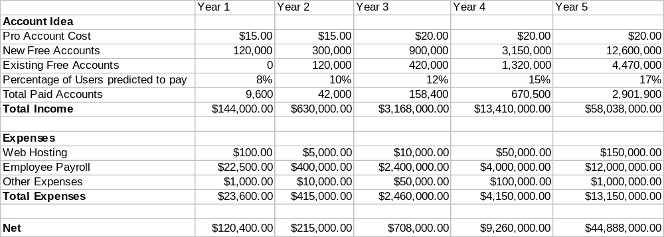
ROI: Return on Investment

Slide 12
Conclusions
Personal Goal: Build a site that I would use. Keep it financially stable. Eventually create other web applications, not necessarily related.
Conclusion: Make a product that people would use and are willing to pay a small amount for. If I can't afford it, it's probably too expensive.

Slide 13
IQ Finalists – April 28, 2007
Inspiring and Fostering
Innovation for Our Future
Learn by Doing…Give Back by Creating…

